Slide 1
Relation Oriented Faceted Search over Knowledge Bases
By
Omar Wassim
Mohamed Ibrahim
Supervised By
Professor Toshiyuki Amagasa Professor Danielle Ziebelin

Slide 2
What are Knowledge Bases
- They are organized repositories of information that store and manage knowledge in a structured format.
- They serve as centralized collections of data, facts, and information about a particular domain or subject.

Slide 3
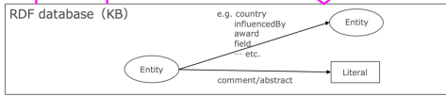
What are Knowledge Bases
Knowledge Bases Structured as an RDF (Resource Description Framework) Database.

Slide 4
What are Knowledge Bases
Knowledge Bases Structured as an RDF (Resource Description Framework) Database.
RDF: A framework for representing information about resources in a machine-readable way. It is a standard model for data interchange on the web. RDF provides a way to describe relationships between resources

Slide 5
Example
writtenBy (Relation)
Writer
Document

Slide 6
The Objective

Slide 7
The Objective
Allow the Exploration of entities in Knowledge Bases.

Slide 8
The Objective
Allow the Exploration of entities in Knowledge Bases.
Provide the ability to find relations between entities.

Slide 9
The Objective
Allow the Exploration of entities in Knowledge Bases.
Provide the ability to find relations between entities.
Make the aforementioned features accessible by designing an easy to use user interface.

Slide 10
Previous Work

Slide 11

Previous Work
Main paper done by Taro Aso supervised by Professor Toshiyuki Amagasa

Slide 12
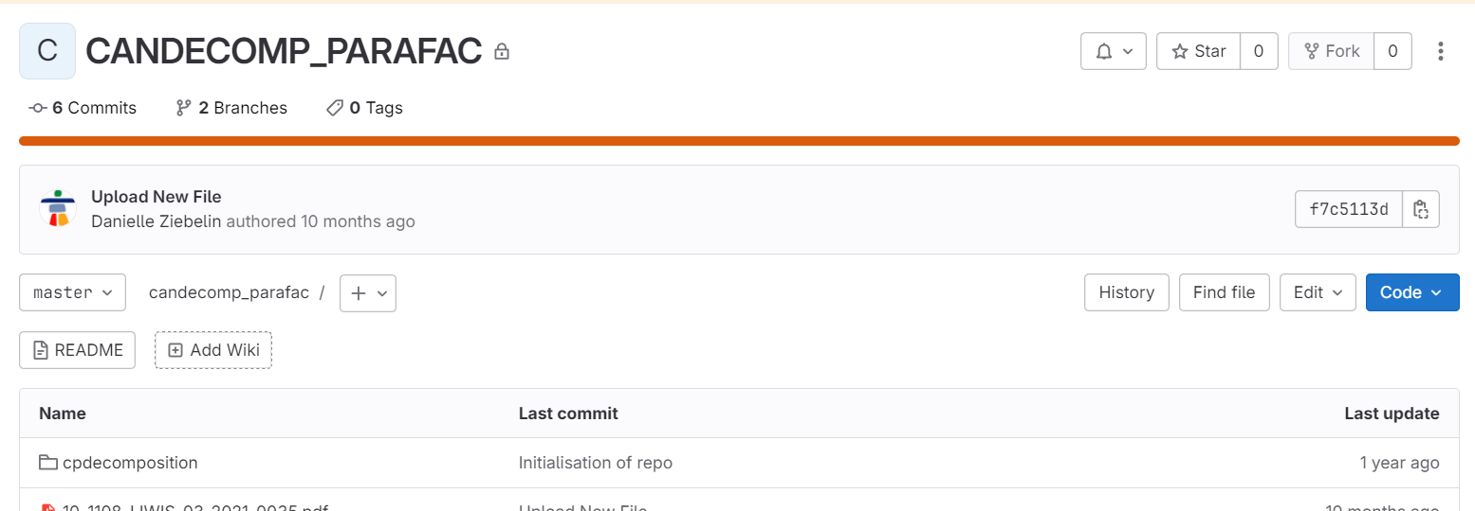
Previous Work
Main paper done by Taro Aso supervised by Professor Toshiyuki Amagasa
Implementation project of Taro Aso’s faceted search system

Slide 13
Main Successes
- Applied faceted search over Knowledge Bases
- Used properties and relations as facets
Relation
Property

Slide 14
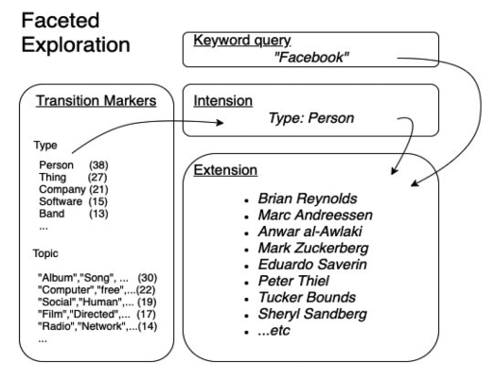
How Faceted Search works

Slide 15
How Faceted Search works
Faster Filtering of results.

Slide 16
How Faceted Search works
Faster Filtering of results.
Fast Traversal between results.

Slide 17
How Faceted Search works
Faster Filtering of results.
Fast Traversal between results.
Shows Relationships between entities.

Slide 18
How Faceted Search works
Faster Filtering of results.
Fast Traversal between results.
Shows Relationships between entities.
Faster Search!!

Slide 19
Challenges Faced
Working with already established code.
Having to recreate the working environment.
Populating the database and interpreting the schema.

Slide 20
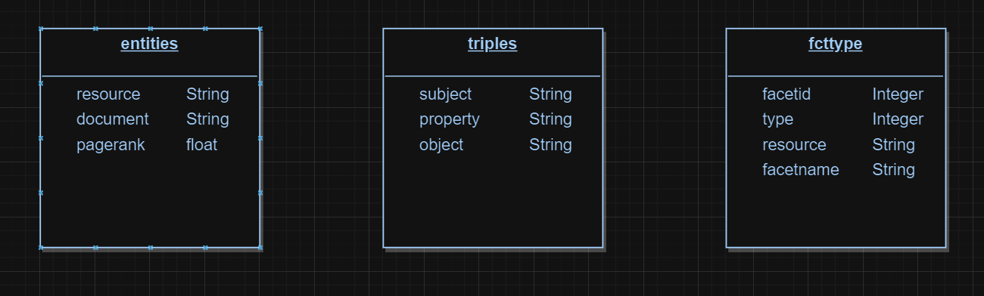
Database Structure

Slide 21
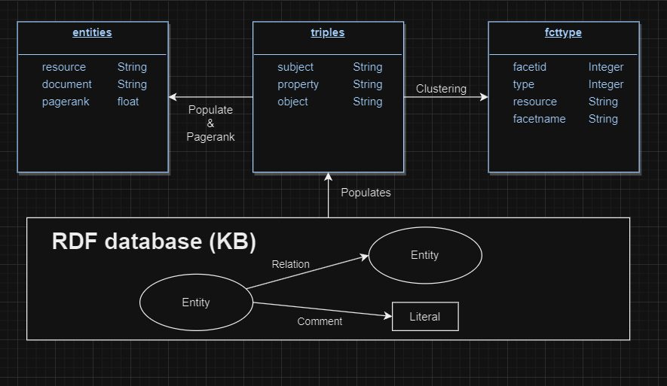
How the Database is Populated
The triples table is populated from the KB dividing each relation between entities into subject, object and property (relation).
The entities table is then populated, and the entities are ranked using the PageRank algorithm
A clustering algorithm is then used to cluster similar relations.

Slide 22
System Implementation
Database Management: PostgreSQL
Database Administration: Adminer
Web Application Framework: Node.js and Express

Slide 23
Thank You

